Slide 1
Tags Phase 1 Overview
Tags Subgroup | 12 April 2018

Slide 2
Tags Subgroup
Ann-Marie Breaux, EBSCO, Tags subgroup convener & PO
Anya Arnold, EBSCO, RA Reserves PO
Charlotte Whitt, Index Data, Inventory & Codex Search PO
Christie Thomas, Univ of Chicago, Data Management
Dennis Bridges, Stacks, Acquisitions PO
Filip Jakobsen, Samhaeng, UX Designer
Simona Tabacaru, Texas A&M Univ, Reporting SIG, Collection Development, Acquisitions

Slide 3
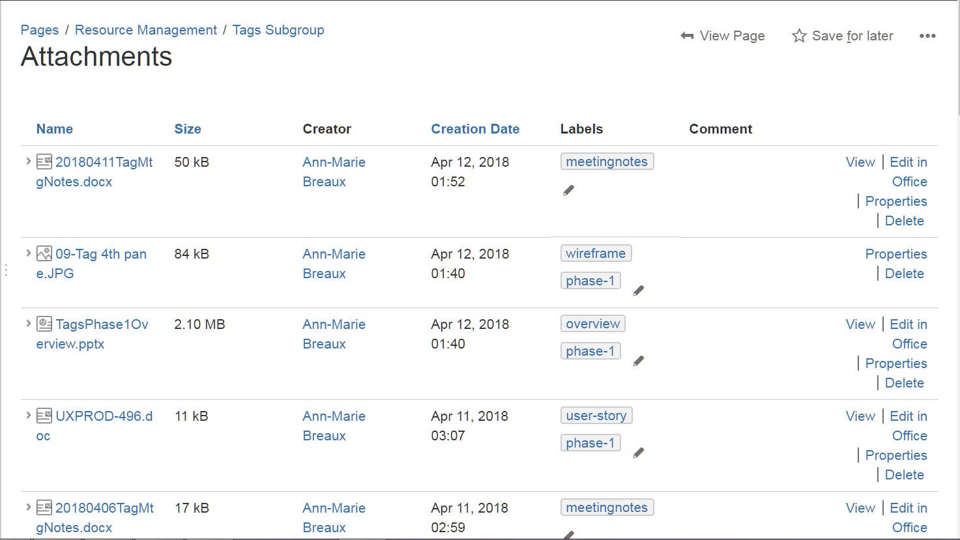
Tags Subgroup
Wiki page: https://wiki.folio.org/display/RM/Tags+Subgroup

Slide 4
What Are Tags?
Brief markers to add to records, to flag with an indicator of some sort
To group records into categories
To use for filtering and reporting
Tag = Label
Tag ≠ Note (longer, more free text)
Tag ≠ Custom Fields (may have add’l, specific functionality)
FOLIO Tag terminology conventions
Assign/Unassign: when working with tags on an individual record
Create/Delete: working with tags in the central tag list

Slide 5
FOLIO: Good Use Cases for Tags
Visual flag on the screen
Bibliographic local codes
Statistical codes
Accreditation categories
Expense categories
Lightweight workflow support
Non-standard, local categories
ePlatform codes
Cataloging administrative codes
Additional granularity for larger fixed codes/categories
Categorize documents within document repositories

Slide 6
Possibly Not-so-good Use Cases for Tags
Codes that drive specific functionality
e.g. retention codes that prevent the last copy from being weeded
Instructor/Course number (tag history not retained over time)
Cases where custom fields might work better
Loan rule categories
Electronic bookplates/donor codes

Slide 7
FOLIO Tags App
Centrally administered app
“Helper app” that acts on records in main FOLIO apps (e.g. User, Instance, Holdings, Item, Order, Vendor, Budget)
Analogous to the Notes app
Library turns the Tag app on or off at the system level
If on: can be consumed by any main app that allows it
If off: will not display or be accessible to any main app

Slide 8
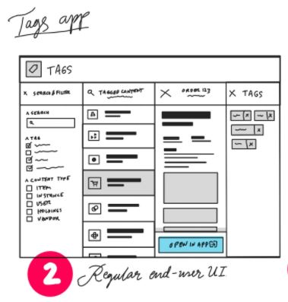
Development Phases
Phase 1: Tags in relation to individual records
Phase 2: Cross-app searching and central administration area for tags
Planning for Phase 2 ASAP after Phase 1

Slide 9
Phase 1: Individual Records
What tags look like on an individual record
Working with tags
Filtering by tags
Permissions
No UI access to central tag list in Phase 1

Slide 10
Individual Records*
Acquisitions Records
Budgets
Funds
Invoices
Ledgers
Orders
Order Lines
Transactions
Vendors
Inventory Records
Instances
Holdings
Items
Packages
ERM Records
TBD
MARCcat Records
TBD
Circulation Records
Requests
Transactions
User Records
Patron Groups?
Permission Sets
Users
Other Records?
* Any data within an app that has a FOLIO UI presenting it as a record,
usually data about some thing, or transactions related to some thing

Slide 11
Tag Indicator in Instance Search Results

Slide 12
Tag Indicator with Existing Tags

Slide 13
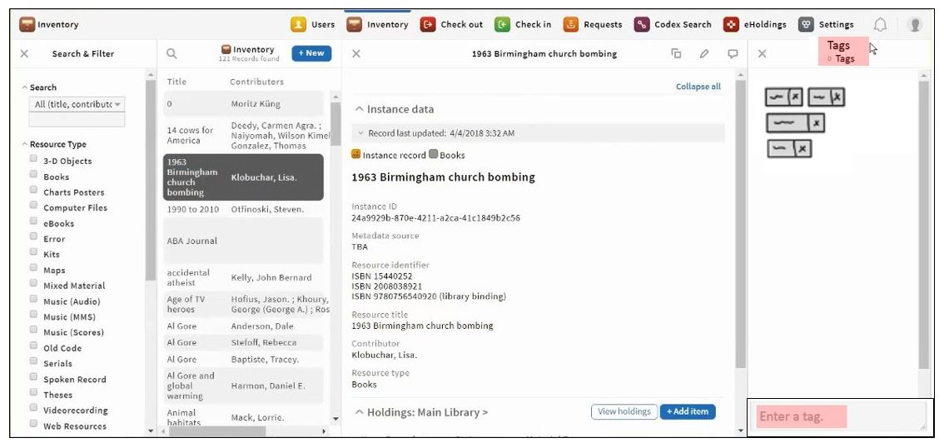
When You Click the Tag Icon
Opens fourth pane

Slide 14
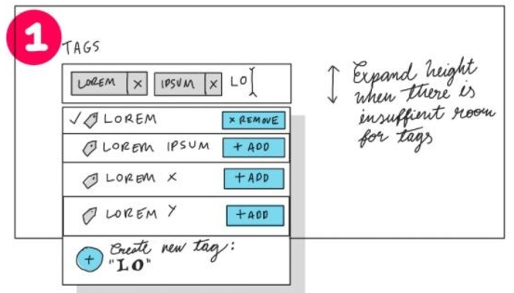
Tag Assignment
Start typing, FOLIO auto-suggests based on existing tags in the central tag list
If tag is already on the record, it is highlighted
If not already on the record, will assign the tag to the record
If tag is not already in the central tag list, will include a red alert message “New tag created”
X next to each tag, so it can be removed
When tag is assigned or unassigned, # next to tag icon increments or decrements by 1

Slide 15
Tag Permissions: Phase 1
View-only - or -
Assign an existing tag to a record (tag already in the central tag list) - or -
Create a new tag and assign to a record (tag is added to the central tag list)
Unassign a tag from a record (removes the tag from the record, but not from the central tag list)

Slide 16
Tag Details
OK:
do-today do_today
do&today dotoday
r-m:do-today acq:april2018
acq-201804 cat-med
Lower-case only
No spaces allowed
No characters disallowed, except space and possibly pipe delimiter
Displayed in alphabetical order on the record
Not OK:
Do Today Do-Today
NewYork Acq:April 2018
Acq201804 Cat Med

Slide 17
Tags as Filters
A new tag filter in the left pane
Only displays tags used on records in that app
Once tag filter is applied, users can work with the records in the result list, e.g.
View each record
Export the batch of records

Slide 18
Phase 2: Tags and Central Admin
What tags look like in central admin area
The tag record, with description field
Searching for tags in central admin
Filter by tag
Filter by record type (user, order, instance, item, etc.)
See all records using a particular tag
Central editing of tags (CRUD)
Create Read Update Delete
Central admin permissions

Slide 19
Next Steps
Developers are analyzing Phase 1 user stories
Subgroup reviewing Phase 1 with interested SIGs
Not sure when Phase 1 development work will be done
Proof of concept with Orders app, or Vendor app, or Inventory app
Tags subgroup finalizing Phase 2 stories
Submit Phase 2 stories to developers by 23 March
Testing and trial
Consider additional functionality for Phase 3

Slide 20
◊ Questions? ◊ Comments? ◊

