Slide 1
Intro to FOLIO Locations
Erin Nettifee
2020-02-27
Locations Small Group

Slide 2
Goals for this session
Introduce the FOLIO location model
Identify (and maybe also answer) questions that we have for Duke’s context.
This will probably come across as Circulation-slanted; please point out areas where I’m missing context that is important to your part of our work.
No questions are bad questions – it’s likely that if you have a question, someone else is wondering the same thing.
You can ask as we go, or save until the end.

Slide 3
How do we know about where an item is or might be in Aleph?
Items belong to Sublibraries. Among other things, Sublibraries allow those libraries to define circulation rules for the items that they own.
Items have Collection Codes, and collection codes translate in Aleph and in TRLN Discovery to names that we can recognize as having specific locations.
Finally: Items have Call Numbers which allow us to give directions in the building(s), since we know where those are.
Notes:
So this is very basic but I think it’s worth reviewing – what are the ways that staff know where an item is located in Aleph?
We have sublibraries – which have lots of uses for our purposes, but for Aleph importantly they are used in Circulation rules. Those are how Music can define how their CDs circulate vs. Ford can define how their CDs circulate. They also have important functions in collection management and just as big buckets for the work that we do.
We know that items have collection codes, and collection codes translate in Aleph as well as in TRLN discovery to locations that we recognize. We know that PKE is the East Asian Collection or PK7 is Duke Authors. Collection codes also provide a way for us to temporarily move an item to another location for the purposes of Aleph and TRLN Discovery. We can use that temporary location checkbox to put the new collection code on and then remove it when whatever need is done.
And then, of course, items have call numbers which allow us to know where something is or should be in a building because we know that floor 3 has a certain call number range, tat kind of thing.
Item Process Status also can give us information about item location, but because that is more related to discussions about FOLIO item state, we’re going to sort of bracket that off from this discussion – but I do want to acknowledge that it is part of that.

Slide 4
How will we know about where an item is or might be in FOLIO?
Items will have locations that are part of a four-level location hierarchy.
Locations are inherited from the holdings record by default.
In addition, both holdings and items have fields for permanent locations and/or temporary locations.
FOLIO has logic for all of this to define an item’s Effective Location, which drives circulation rules
(and FOLIO definitely has call numbers.)
Notes:
So, at a very high level before we dive in – where will we know where an item is, or might be, in FOLIO?
FOLIO items will have locations – think of it as “shelving location” if that helps, but it’s labeled as location in the GUI – that are part of a four-level location hierarchy.
Locations are inherited from the holdings record by default.
FOLIO also has the concept of a permanent and a temporary location, on both the holding and the item record.
Then, FOLIO has logic for all of this to define an item’s effective location, and the effective location drives circulation rules, and other things like fine payment, things like that.
And FOLIO definitely has call numbers

Slide 5
FOLIO Location Tree
Institution
Campus
Library
Location
Locations are set in Settings → Tenant.
Circulation rules can be written at each of these levels - and they apply to the level *and the places below it in the hierarchy*
Notes:
So, locations are managed through the GUI in Settings, and they appear in Settings → Tenant. If you look in our Duke test instance right now, you will actually see some Duke values in there. I want to remind everyone that those values are iterative – we’re working on test data – and so what’s in there is almost entirely a straight up mapping of the Aleph info over. Don’t look at that and think that decisions were already made, they haven’t been, and it’s especially important through this to make sure we’re not just replicating things because that’s how we’ve always done them.
So it goes from Institution down to location in the hierarchy, broadest to most specific, and I want to note that while these have specific associations for many of us – e.g., a library is Lilly, a location is Lilly stacks – there is nothing in the FOLIO code that requires us to treat these things that way. Campus, for example, could be East and West, or it could be DUL and Professional. We have control here over how we may want things to work.
From the standpoint of the circulation rules, they can be written at each of these levels, and they apply to the level and everything below it in the hierarchy. So what that means is that, if for example, we can all agree that everything gets laptop chargers for three hours, we could write one rule for all of the libraries at once, instead of nine.

Slide 6
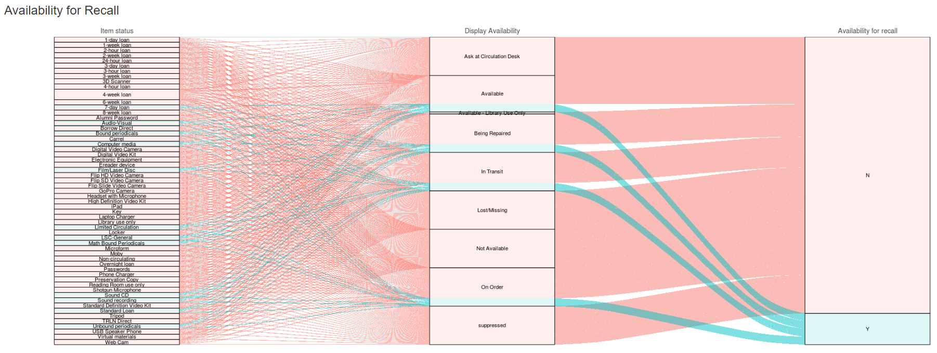
Notes:
And one of the big things that that leads into and a driver of this discussion from the circ side is that we need to look at are our circulation rules. I realize that many of you haven’t looked at the underlying Aleph circulation tabs, but they are tremendously complicated.
Angela Zoss helped LSIS last year with building a rules visualization tool that I think can give some sense of just how complicated these things are – so this is the ability for staff to recall items from Perkins Library.
This is like, just one possible circulation question that you could want to answer.
So I bring this up only to highlight that one of the things that we are thinking about as we start this very beginning part of our process analysis is, how can we make our lives simpler, and how can we make things easier for patrons to understand – in addition to meeting the needs of library staff to manage our collections in the way they need to be managed.

Slide 7
Institution
Institution is the top of the hierarchy.
(Institution → Campus → Library → Location)
May affect time zones and currency support (e.g., DKU)
Possible approaches (just as examples)
One institution - Duke
Two institutions - Duke and Duke Kunshan
Notes:
OK, so let’s dig a little into the pieces of the location hierarchy.
The top level is Institution. We can write circulation rules at this level if we want to.
An open question at this level is how FOLIO will implement time zone and currency support – so for example, how we can support Duke Kunshan effectively so that their loans aren’t due at noon their time instead of midnight. We don’t know yet how this will proceed.
For each of these four pieces I’ll present some thoughts on possible approaches – with none of it being an assumption that a particular approach is the right choice or a realistic choice – but to try to prime some of our discussion and thought process as we work through these, and to make the point that we could have some opportunity here to think more out of the box about our information.
So in any case, we could perhaps decide that we just want one institution – Duke – and nest everything else underneath it. We could potentially also decide that we want two institutions – Duke, and Duke Kunshan. Or maybe there’s another scenario that one of our team members could bring up that could have value for us.

Slide 8
Campus
Campus is the second level of the hierarchy.
(Institution → Campus → Library → Location)
May affect time zones and currency support (e.g., DKU). Does not have to be based on geography.
Possible Approaches (just as examples)
Two campuses: Duke, Kunshan
Three campuses: Duke, Kunshan, DUML
Three campuses: DUL, Professional, Kunshan
Notes:
Then the next level is the Campus level, and that’s the second level of the hierarchy.
Again, because we don’t know yet how time zones might be supported, we don’t know where Kunshan might need to be on this level. I don’t think there’s been any discussion about doing it at a level lower than campus, but it definitely is something we will have to factor in.
This does not have to be a geographic part of the hierarchy if we can see value in other ways. For example, we could decide that we want to have a campus that is DUL, and a campus that is Professional School Libraries. That would allow us to write circulation rules that apply to all DUL libraries with one line in the circulation rule editor, and then the professional school libraries could write their own rules.
We have also had some ideas about possibly listing libraries at this level, to allow them to have two levels underneath. For example, if Rubenstein or another library wanted to have two levels of hierarchy underneath their library for organizing item location information, perhaps they should be mapped to the campus level. Now, that could be something where data mapping issues become really complicated and maybe prohibitive, but if that’s something that could be helpful for us, I want this group to pursue some of those questions.

Slide 9
Library
Library is the third level of the hierarchy.
(Institution → Campus → Library → Location)
Possible Approaches (just as examples)
Map existing sublibraries in Aleph
Opportunity to retire sublibraries like VESIC, LINK, CHEM
Map larger collections up to this level to allow for granularity below.
Notes:
The third level is library – which is at the third level of the hierarchy.
Some possible approaches – again, just as examples, and not with an assumption as to whether these are realistic. One is to map our existing sublibraries in Aleph, and take this as an opportunity to retire sublibraries that are no longer meaningful for patrons, like VESIC, LINK, and Chem.
Another possibility could be to map larger collections to the library level – for example, the East Asian Collection could become its own library, with shelving locations underneath it.

Slide 10
Location
Location is the fourth and most specific level of the hierarchy.
(Institution → Campus → Library → Location)
Provides location name to the discovery layer (specific field)
Possible Approaches:
Most straightforward: mapping of collection codes
Could be other approaches, depending on our needs.
Notes:
And then location – or shelving location, is the fourth and most specific level of the hierarchy.
Location in general has more detail on the record and more dependencies than the three layers higher in the list. For example, locations are connected to the FOLIO concept of service points, and a location connected to a service point is how FOLIO will know where to route those items for handling, where to send requests, where to print hold slips, how to charge fees and fines.
Locations are also designed to be the level at which item information is exposed to the discovery layer – which makes sense right, since this is shelving location – and so a location record has the option to have a Discovery name in addition to an internal FOLIO name.
In terms of possible approaches – continuing my process of thinking out loud – the one that’s probably the most straightforward is to think about the mapping of collection codes. But there certainly could be other ways that we could attack this.

Slide 11
So, let’s look at duke-test.

Slide 12
A few questions to get it started…
What, if any, locations are needed to support electronic records?
What level of granularity do we want to implement? What are the rewards and tradeoffs of doing an “unconventional” approach – for example, mapping a current Aleph sublibrary to the campus level? (Consider for both mapping items into FOLIO from Aleph, and creating items in FOLIO directly)
How will location management occur with items sent to the LSC?
What naming convention for Locations give us the best functionality within the apps?
How will fine management for lost items differ from fine management for overdue items with regards to locations?
Notes:
So, here is a list of questions that I have when I’ve thought about this – that we may or may not be able to resolve in the next month, but which I think we all need to have a good understanding of as part of this.
I also want to stop here and see what other questions have emerged for each of you, as I’ve done this set of slides.

