Slide 1
Data sync working group
TC Updates & Outcome
August 3, 2022

Slide 2
Background
Data synchronization or consistency refers to whether the same data kept at different places matches or not
Data sync issues raised in App Interaction SIG
“Maintain relationship between apps when holdings/items are moved” (UXPROD-1647)
Collection of use cases across apps (Wiki)
Analysis of expected behavior in AI SIG
Task by TC: Form working group
Goal: find solution / pattern that would work for majority of use cases

Slide 3
Working group members
Marc Johnson
Owen Stephens
Charlotte Whitt
Brooks Travis
Raman Auramau
Zak Burke
Martina Schildt

Slide 4
Steps
Grouped use cases into categories
Specified Source of Truth for different use cases
Discussed possible approach and checked use cases against it
Survey to learn about acceptable delay for all data changes to be synced

Slide 5
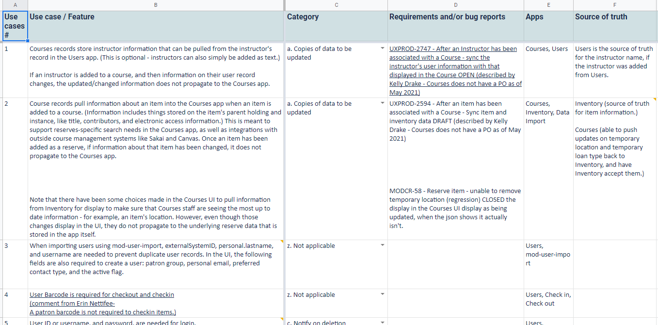
Example of Use cases
Link to spreadsheet

Slide 6
Categories
List of categories
Understanding
a. Copies of data to be updated
b. Notify on use of data in other apps (requires further review)
c. Notify on deletion
d. Block on deletion (requires further review)
e. Notify on data update
these categories describe use cases, not the solutions
use cases of category a, e and c can all be solved by the proposed approach; the others are still to be reviewed
how an individual module implements the solution is up to the implementing developers and SMEs

Slide 7
Guiding principles
Solution should be generally applicable for the categories of use-cases it could solve
FOLIO is a modular system consisting of loosely-coupled parts called modules
Avoid hard dependencies (especially on the back-end)
Modules that provide data are not able to be aware of all the modules that may wish to reference/consume their data
Avoid adding new to the “tech stack” if possible
Reliability and performance are important

Slide 8
Basic solution concepts
Eventual Consistency pattern
very briefly, eventual consistency means that if the system is functioning and we wait long enough after any given set of inputs, we will eventually be able to know what the state of the database is, and so any further reads will be consistent with our expectations
Domain Event pattern
a service (or a module, or an application) emits so called domain events when domain objects/data changed, and publishes these domain events to a notification channel so that they can be consumed by other services
Single Source of Truth
an application that owns the original data

Slide 9
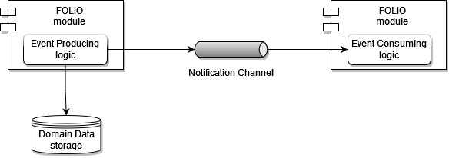
Solution summary
FOLIO Cross-application Data Sync Proposal
Solution includes the following logical parts:
Event Producer
Notification Channel
Event Consumer

Slide 10
Event Producer details
Event Producer posts changes to a notification channel
Event Producer is to be in a FOLIO module acting as a Single Source of Truth
Event Producer is to be located as close to Domain Data storage as possible
Transactional outbox pattern MUST be implemented in Event Producer to reliably update the Domain Data storage and publish events

Slide 11
Notification Channel & Event Consumer details
Apache Kafka is proposed as a message broker
Event Consumer is responsible for
reading updates from the Notification Channel
subsequent processing of this event in accordance with its own needs
The solution is to support at-least-one delivery, consequently Event Consumer MUST be idempotent and be able to process repeated event
No way to know about delay or whether event consumer is in sync

Slide 12
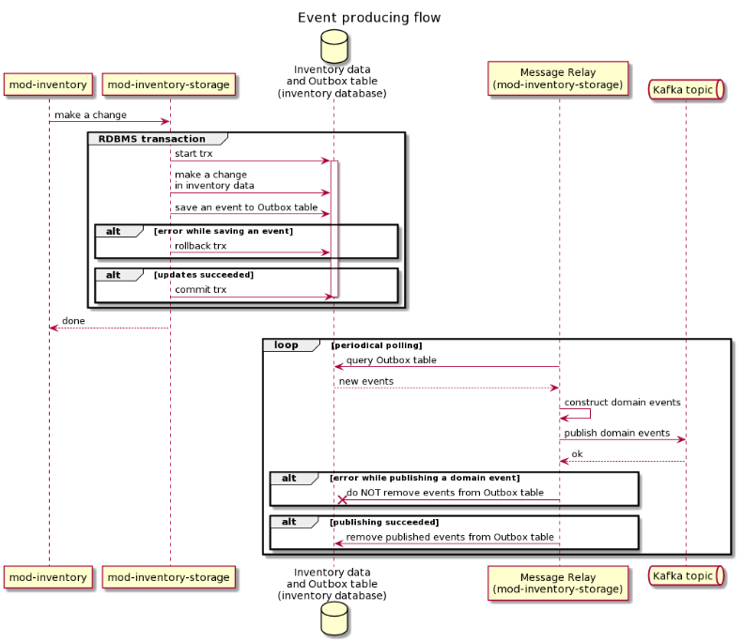
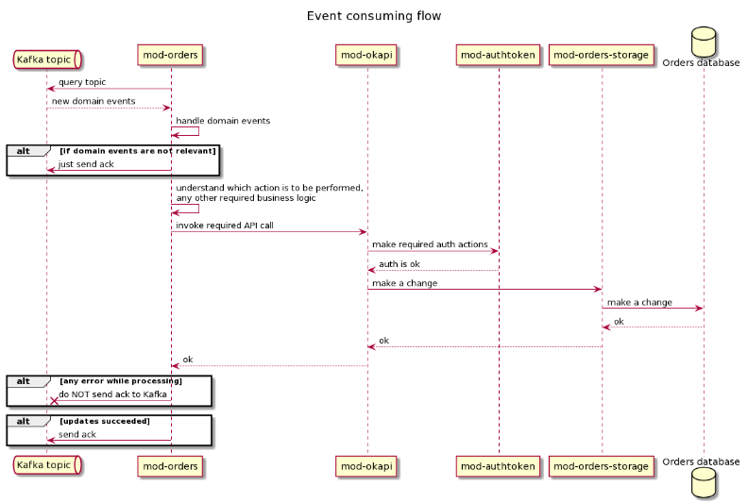
Sequencing

Slide 13
Good news…
This approach is already in-use in FOLIO
mod-inventory-storage -> mod-search is a “notify on update”
mod-inn-reach is also using mod-inventory-storage events and the developers there also implemented events for some circulation-storage models, as well (loans, requests, and check-ins)
The infrastructure necessary to support the approach is already in-use (Kafka as the message broker)
Experience implementing these types of solutions already exists in the project
The existing implementation can provide a performance baseline
Once implemented, the Event Producer and its domain events can be reused by Event Consumers

Slide 14
Assumptions
It is possible to identify a Single Source of Truth (i.e. an application owning domain data) in a particular use case
Retention policy will always be long enough for messages to be consumed by a receiving module
Initial data synchronization is performed during the data migration as a part of a feature release
The hoster provides a reliable and stable Kafka service, including data backup to avoid losing events
Regarding the eventual consistency principle, in the current design, it is up to the implementer (of the Event Consumer) to handle failures in a way that supports this. Though there are likely failure scenarios where the consumer may never become consistent again

Slide 15
Challenges
Outbox pattern in RMB
The issue is with transactional work with DB - cannot make changes to record and put message into outbox in same transaction
Re-writing DS module with Spring, or https://debezium.io/ as an alternative to Outbox pattern
Inbox pattern in case of BL and DS separation
Kafka exactly-once (check with Kafka documentation v. 2.4+)
Downstream OkApi calls from the Event Consumer
Discovery problem - how to find out OkApi URL for sending requests
Permission problem - how to grant permission to send requests
PII / sensitive data protection
Kafka authN/Z allowing to address unauthorized access to the data in general
Filtering out of PII / sensitive data (similar to filtering while logging)

Slide 16
Challenges
Resource consumption with full body
Full body - minimum of OkAPI usage
Only dif for updates? Binary format for Kafka messages
Version compatibilities
Versioning should be included into event schema
Both the record representation schema and the message schema can / should be versioned

Slide 17
Links and further information
Confluence space
Google Drive
Documents
Use cases
Proposed solution

Slide 18
What questions & feedback do you have?

Slide 19
Appendix - Solvable use cases
Use case | Category | Source of truth
When an instructor on a course is linked to a FOLIO user, and the instructor's name changes, Users should update the name in Courses. | a - Copies of data to be updated | Users is the source of truth for the instructor name, if the instructor was added from Users.
Courses should be able to edit the temporary location and temporary loan type, and listen to changes in Inventory. | a - Copies of data to be updated | Inventory (source of truth for item information.) Courses (able to push updates on temporary location and temporary loan type back to Inventory, and have Inventory accept them.)
When changing the requester’s user data (names, barcode) in Users, it should update the requester data on Requests. | a - Copies of data to be updated | Users

Slide 20
Appendix - Solvable use cases
Use case | Category | Source of truth
Item and instance attributes copied to Requests should be updated, when the Inventory instance, holdings, or item records are updated (if necessary). | a - Copies of data to be updated | Inventory
Maintain relationship between apps when holdings/items are moved in Inventory. UXPROD-1647 | a - Copies of data to be updated | Inventory
Fund code should be consistent between fund record in Finances and fund code on POL in Orders. | a - Copies of data to be updated | Finances

Slide 21
Appendix - Solvable use cases
Use case | Category | Source of truth
Organization name updates should be synced with cached name in Agreements and Licenses. | a - Copies of data to be updated | Organizations
Organization code should be consistent between Organization record and organization code on Purchase Order. | a - Copies of data to be updated | Organizations
Request state and details: some modules outside of mod-circulation may need to be aware of changes in the state or details of a request to perform actions such as communicating with a 3rd-party request broker. | e - Notify on data update | Requests

Slide 22
Appendix - Solvable use cases
Use case | Category | Source of truth
When deleting a User record in UI, inform other apps that the user record has been deleted. | c - Notify on deletion | Users
When deleting an Inventory instance record in UI, inform other apps that the instance record has been deleted. UXPROD-1624 | c - Notify on deletion | Inventory
When deleting an Organization record in UI, inform other apps that organization record has been deleted. | c - Notify on deletion | Organizations

Slide 23
Appendix - Use cases out of scope
Use case | Category | Source of truth
Check on linked POLs in Orders when an Item/Holding/Instance is deleted in Inventory. | d - Block on deletion | Inventory
Check on linked Requests when an Item/Holding/Instance is deleted in Inventory. | d - Block on deletion | Inventory

Slide 24
Appendix - Use cases already solved
Use case | Category | Source of truth
On attempt to delete a License record, do not delete if license is related to an Agreement. Already implemented with a hardcoded lookup at the point the user tries to delete a license. | d - Block on deletion | Licenses
When deleting holdings and items in Inventory, check for dependencies in other apps. A check is already implemented when deleting holdings and items: UIIN-534: Item record. Delete (only) - check on dependencies with other apps UIIN-550: Holdings record. Delete (only) - second phase. Dependencies with associated item records | d - Block on deletion | Inventory

Slide 25
Appendix - Use cases already solved
Use case | Category | Source of truth
When deleting a User record in UI there is a check for dependencies in other apps. UXPROD-2388 - Delete user through the UI with check for open transactions (UI, Single user) UXPROD-2728 - Delete user through the API with check for open transactions (API, Single user) | d - Block on deletion | Users

