Slide 1
Inventory. Result list. Survey. Order of columns
Working group:
Laura Wright, Susan Kimball and Charlotte Whitt
10/7/2020

Slide 2
Relevant features:
UXPROD-1634 (index title/title) - R1 2021 Honeysuckle release
UXPROD-2667 (sort on contributor, when more than one contributor is listed)
UXPROD-2668 (adding instance HRID)
UXPROD-2669 (adding resource type)
UXPROD-2670 (adding format)
UXPROD-2671 (adding edition)
UXPROD-2703 (adding publication date)

Slide 3
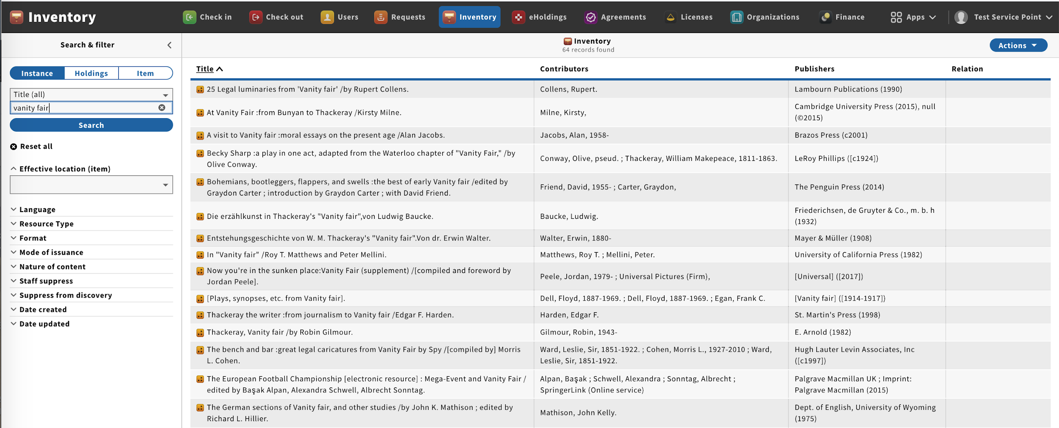
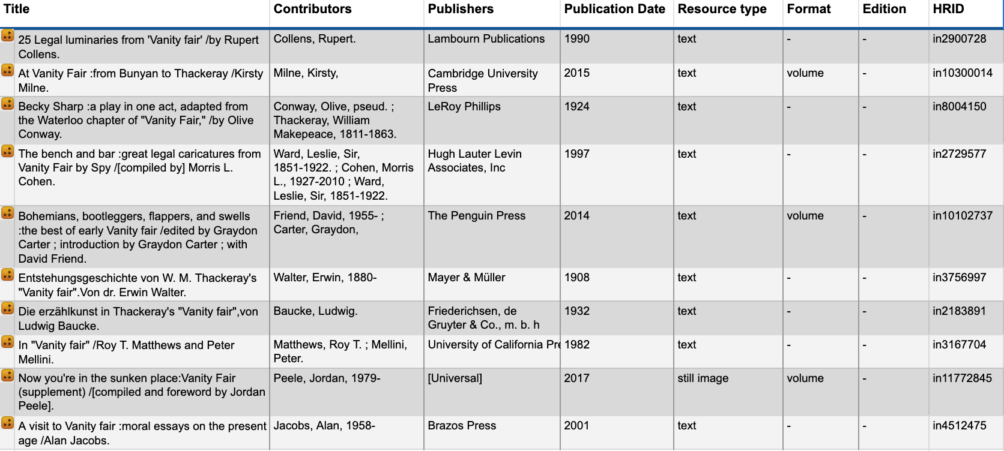
Alabama: Prefered order of the columns in the result list?
Mark with numbers 1-8 - by drag and drop ->
1
2
4
3
7
6
5
8
Notes:
Spreadsheet: https://docs.google.com/spreadsheets/d/1XLtdhnaHJz4Vb3G8FcHjso_LAUFdEzETo_50f8SYDrY/edit#gid=0
Examples from Bugfest-Goldenrod: https://bugfest-goldenrod.folio.ebsco.com/inventory/view/0e45c5b6-1d48-4ec7-a016-bd8c8181eb16?qindex=title&query=vanity%20fair&sort=title

Slide 4
BNCF: Prefered order of the columns in the result list?
Mark with numbers 1-8 - by drag and drop ->
1
2
4
3
5
6
7
8

Slide 5
Chalmers: Prefered order of the columns in the result list?
Mark with numbers 1-8 - by drag and drop ->
8
1
2
5
3
6
7
4

Slide 6
Chicago: Prefered order of the columns in the result list?
Mark with numbers 1-8 - by drag and drop ->
1
2
3
4
5
6
7
8

Slide 7
Cornell: Prefered order of the columns in the result list?
Mark with numbers 1-8 - by drag and drop ->
1
2
4
7
3
5
6
8

Slide 8
Duke: Prefered order of the columns in the result list?
Mark with numbers 1-8 - by drag and drop ->
1
2
3
4
5
6
7
8

Slide 9
Five colleges: Prefered order of the columns in the result list?
Mark with numbers 1-8 - by drag and drop ->
2
3
5
4
7
8
6
1

Slide 10
GBV (Bremen): Prefered order of the columns in the result list?
Mark with numbers 1-8 - by drag and drop ->
1
2
3
4
5
6
7
8

Slide 11
GBV (ZBW): Prefered order of the columns in the result list?
Mark with numbers 1-8 - by drag and drop ->
1
2
3
4
5
6
7
8

Slide 12
Hungary: Prefered order of the columns in the result list?
Mark with numbers 1-8 - by drag and drop ->
1
2
3
4
5
6
7
8

Slide 13
Lehigh: Prefered order of the columns in the result list?
Mark with numbers 1-8 - by drag and drop ->
3
4
5
6
2
8
7
1

Slide 14
Leipzig: Prefered order of the columns in the result list?
Mark with numbers 1-8 - by drag and drop ->
1
2
3
4
5
6
7
8

Slide 15
MSU: Prefered order of the columns in the result list?
Mark with numbers 1-8 - by drag and drop ->
2
4
7
8
5
6
1
3
Notes:
FINAL

Slide 16
St. Thomas: Prefered order of the columns in the result list?
Mark with numbers 1-8 - by drag and drop ->
1
2
3
4
5
6
7
8

Slide 17
Shanghai Library: Prefered order of the columns in the result list?
Mark with numbers 1-8 - by drag and drop ->
5
6
7
8
1
2
3
4

Slide 18
Simmons: Prefered order of the columns in the result list?
Mark with numbers 1-8 - by drag and drop ->
1
2
3
4
5
6
7
8

Slide 19
Spokane Public Library: Prefered order of the columns in the result list?
Mark with numbers 1-8 - by drag and drop ->
1
2
3
4
5
6
7
8

Slide 20
TAMU: Prefered order of the columns in the result list?
Mark with numbers 1-8 - by drag and drop ->
1
2
3
4
5
6
7
8

Slide 21
Washington & Jefferson College: Prefered order of the columns in the result list?
Mark with numbers 1-8 - by drag and drop ->
1
2
3
4
5
6
7
8

Slide 22
Warner: Prefered order of the columns in the result list?
Mark with numbers 1-8 - by drag and drop ->
1
2
3
4
5
6
7
8

Slide 23
Wentworth: Prefered order of the columns in the result list?
Mark with numbers 1-8 - by drag and drop ->
1
2
3
4
5
6
7
8

