Slide 1
UXPROD-2663
Inventory. Item detail list. Configurable per tenant
Survey - 9/17/2020 Charlotte Whitt

Slide 2
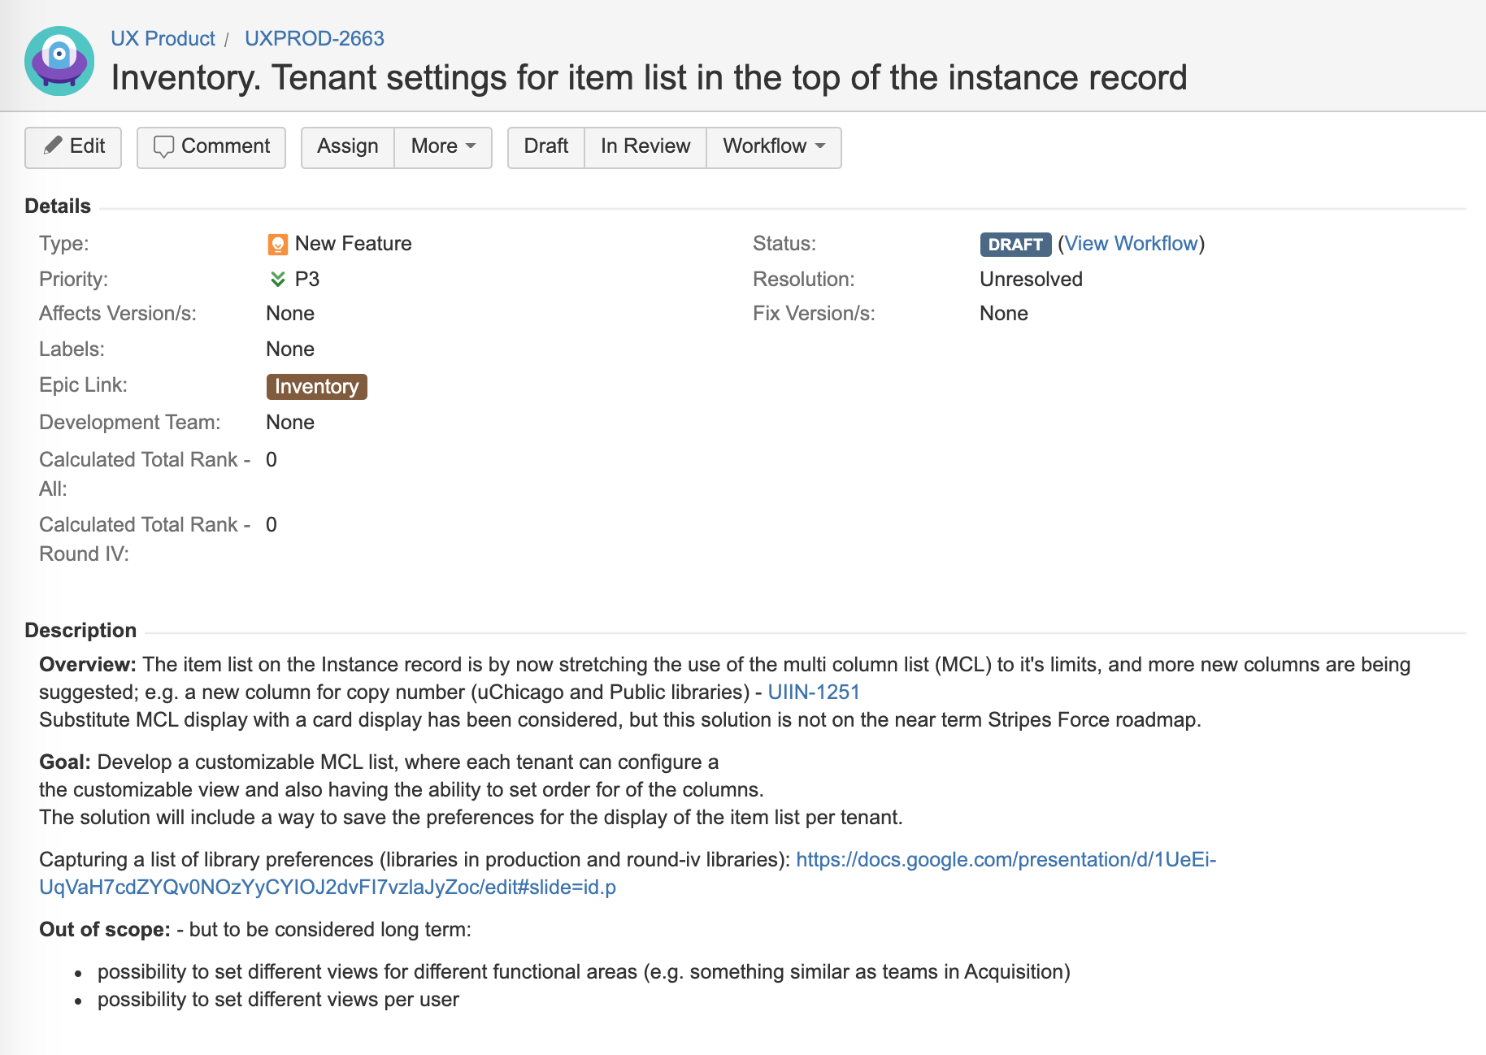
Card display (long term). Customizable MCL short term.
New feature:
To be ranked by the libraries
To be estimated by developers

Slide 3
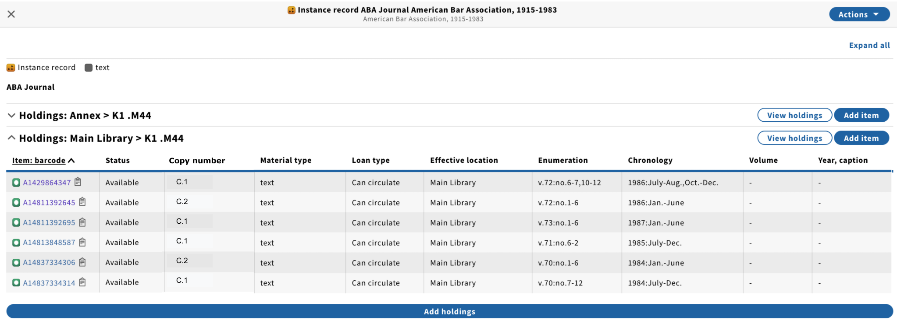
Gather real life examples (production + round-iv)
View with the suggested new column for copy number (UIIN-1251):

Slide 4
Tenant/user defined display of result list
Ability to configure the displayed columns
Tenant-defined display preferences would be easier but not sure how valuable. Charlotte will discuss with MM SMEs and potentially create a feature for this approach.
User-defined display preferences would require user preference infrastructure. It would also make it difficult to troubleshoot issues if every user had a different view

Slide 5
Task: Each library customize their preferred view
Cross out columns not needed. Enter numbers defining the order of columns. E.g.
1
2
3
4
5
6
7
8
9
10

Slide 6
Made up example of preferred view
Cross out columns not needed. Enter numbers defining the order of columns. E.g.
9
10
1
3
2
5
4
6
7
8

Slide 7
Alabama: customized item list display
Cross out columns not needed. Enter numbers defining the order of columns. E.g.
1
2
3
4
5
6
7
8
9
10

Slide 8
Chalmers: customized item list display
Cross out columns not needed. Enter numbers defining the order of columns. E.g.
7
8
9
10
1
2
6
3
5
4

Slide 9
BNCF: customized item list display
Cross out columns not needed. Enter numbers defining the order of columns. E.g.
1
2
3
4
5
6
7
8
9
10

Slide 10
Chicago: customized item list display
Cross out columns not needed. Enter numbers defining the order of columns. E.g.
7
8
9
10
2
3
4
6
1
5

Slide 11
Cornell: customized item list display
Cross out columns not needed. Enter numbers defining the order of columns. E.g.
Opinions differed -- this is an attempt to represent some conflicting desires
8
9
10
2
7
5
6
1
3
4

Slide 12
Duke: customized item list display
Cross out columns not needed. Enter numbers defining the order of columns. E.g.
1
2
3
4
5
6
7
8
9
10

Slide 13
Five colleges: customized item list display
Cross out columns not needed. Enter numbers defining the order of columns. E.g.
9
10
1
7
8
5
6
2
3
4

Slide 14
GBV: customized item list display
Cross out columns not needed. Enter numbers defining the order of columns. E.g.
10
1
2
9
5
3
4
6
8
7

Slide 15
Hungary: customized item list display
Cross out columns not needed. Enter numbers defining the order of columns. E.g.
1
2
3
4
5
6
7
8
9
10

Slide 16
Lehigh: customized item list display
Cross out columns not needed. Enter numbers defining the order of columns. E.g.
6
7
8
9
10
1
2
3
4
5

Slide 17
Leipzig: customized item list display
Cross out columns not needed. Enter numbers defining the order of columns. E.g.
1
2
3
4
5
6
7
8
9
10

Slide 18
MSU: customized item list display
Cross out columns not needed. Enter numbers defining the order of columns. E.g.
7
8
9
10
1
3
2
5
6
4

Slide 19
St. Thomas: customized item list display
Cross out columns not needed. Enter numbers defining the order of columns. E.g.
1
2
3
4
5
6
7
8
9
10

Slide 20
Shanghai Library: customized item list display
Cross out columns not needed. Enter numbers defining the order of columns. E.g.
6
7
8
9
10
1
4
3
2
5
Notes:
SHL notes: When possible to have the item list configurable, then the goal will be solution 1 (see slide #27), and eventually solution 2 (see slide #28)

Slide 21
Simmons: customized item list display
Cross out columns not needed. Enter numbers defining the order of columns. E.g.
1
2
3
4
5
6
7
8
9
10

Slide 22
Spokane Public Library: customized item list display
Cross out columns not needed. Enter numbers defining the order of columns. E.g.
1
2
3
4
5
6
7
8
9
10

Slide 23
TAMU: customized item list display
Cross out columns not needed. Enter numbers defining the order of columns. E.g.
1
2
3
4
5
6
7
8
9
10

Slide 24
Washington & Jefferson College: customized item list display
Cross out columns not needed. Enter numbers defining the order of columns. E.g.
1
2
3
4
5
6
7
8
9
10

Slide 25
Warner: customized item list display
Cross out columns not needed. Enter numbers defining the order of columns. E.g.
1
2
3
4
5
6
7
8
9
10

Slide 26
Wentworth: customized item list display
Cross out columns not needed. Enter numbers defining the order of columns. E.g.
1
2
3
4
5
6
7
8
9
10

Slide 27
SHL’s requirements - Customer Configurable Solution 1

Slide 28
SHL’s requirements - Customer Configurable Solution 2

